Slide 1
HRMG200 HUMAN RESOURCE MANAGEMENT: STAFF AND EMPLOYEE ENGAGEMENT
Week Two: Strategic Human Resource Management

Slide 3
Lecture Outline
Define Strategy and Strategic Management
Discuss Types of Strategies
Define Strategic HRM, the Strategic Process and HR Competencies

Slide 4
Introduction
The SHRM model highlights the need to adopt a flexible, agile and strategic perspective when dealing with the external environments of organisations.
In the past decade, there have been significant shifts in the economic environment and the sociopolitical context in which HRM and business organisations operate.
Some of these changes present new problems and others present intensified challenges for strategic human resources management.

Slide 5
Define Strategy
The notion of strategy derives from the military (the ‘art of the general’) and has led some people to think that only the visionary work of leaders is strategic and that managing the operations of firms is not important
Strategy defines the direction in which an organisation intends to move and establishes the framework for action to get there.
Stakeholders are individuals, groups or organisations that are affected by or have a vested interest in an organisation’s policies or decisions.

Slide 6
Strategic Management
Strategic management is a process, an approach that addresses the competitive challenges an organisation faces
It can be thought of as managing the ‘pattern or plan that integrates an organisation’s major goals, policies and action sequences into a cohesive whole’ (Quinn 1980)

Slide 7
Strategic Management
Strategic Management involves:
Strategy formulation
Organisational mission and objectives
Environmental analysis
Strategy selection and implementation
Performance evaluation and feedback.

Slide 8
Types of Strategies
Porters’ generic strategies:
cost
differentiation
focus
Miles & Snows’ strategic types:
defender
analyser
prospector
reactor
Notes:
Cost leadership means having the lowest per-unit (i.e., average) cost in the industry – that is, lowest cost relative to your rivals.
This could mean having the lowest per-unit cost among rivals in highly competitive industries, in which case returns or profits will be low but nonetheless higher than competitors
Or, this could mean having lowest cost among a few rivals where each firm enjoys pricing power and high profits.
Differentiating the product offering of a firm means creating something that is perceived industry wide as being unique.
It is a means of creating your own market to some extent.
There are several approaches to differentiation:
Different design
Brand image
Number of features
New technology
A differentiation strategy may mean differentiating along 2 or more of these dimensions.
Here we focus on a particular buyer group, product segment, or geographical market.
The focus or niche strategy is built on serving a particular target (customer, product, or location) very well.

Slide 9
‘Stuck in the Middle’
Porter argues that failure to develop a strategy in one of these 3 directions is a firm that is “stuck in the middle.”
This means you lack the market share, capital, and overhead control to be a cost leader, and lack the industry wide differentiation necessary to remain sustainable and competitive.

Slide 10
Miles and Snow Strategic Types
The Miles-Snow typology is one of the most popular classifications of business-level strategies.
Beginning in the early 1970s and continuing through the mid-1980s, Miles and Snow explored the strategies of hundreds of companies in numerous industries.

Slide 11
Defender
Miles and Snow argued that they addressed administrative problems by providing management with the ability to centrally control all organisational operations.
A defender resembles a classic bureaucracy in which only top-level executives have the necessary information and the proper vantage point to control operations that span several organisational subunits.

Slide 12
Prospector
Prospectors continually search for product and market opportunities, and regularly experiment with potential responses to emerging environmental trends.
They often pioneer the development of new products and are the creators of change and uncertainty to which competitors must respond.
A prospector distributes power across different parts of the organisation in order to encourage flexible and innovative behaviour that will allow it to locate and exploit opportunities for new ventures.

Slide 13
Analyser
Analysers work in stable and changing product-market domains.
In a stable domain, analysers operate routinely and efficiently through the use of a formal structure and processes.
In more dynamic domains, although they are not usually "first movers," competitors are closely watched for new ideas.
Analysers then quickly adopt those ideas that appear to hold promise.
They are viewed as a mix between the defender and the prospector.

Slide 14
Reactor
Reactors are organisations in which top managers perceive high levels of environmental uncertainty but lack any consistent strategy for responding to this (i.e.: The GFC).
Miles and Snow describe reactors as seldom making adjustments of any sort until forced to do so by environmental pressures.
Unlike defenders or prospectors, reactors have no predictable organizational structure; some may be centralised, whereas others are decentralised.

Slide 15
Strategic Management Process
Strategy formulation:
the process of deciding on a strategic direction by defining a company’s mission and goals, its external opportunities and threats, and its internal strengths and weaknesses
Strategy implementation:
the process of devising structures and allocating resources to enact the strategy chosen by a company

Slide 16
Types of Organisational Strategies
Growth
Retrenchment
Stability
A combination of growth, retrenchment and stability
International strategies (global, multi-domestic, transnational).

Slide 17
Strategic HRM
Strategic HRM is the pattern of planned HR deployments and activities intended to enable an organisation to achieve its goals
It entails assessing the employee skills required to run systems such as total quality management and just-in-time and engaging in HR practices such as selection and training that develop needed skills
Strategic choice is the ways an organisation will attempt to fulfil its mission and achieve its long-term goals

Slide 18
Definition – John Storey
‘A distinctive approach to employment management which seeks to achieve competitive advantage through the strategic deployment of a highly committed and capable workforce using an array of cultural, structural and personnel techniques’. (Storey, 2001: 6)

Slide 19
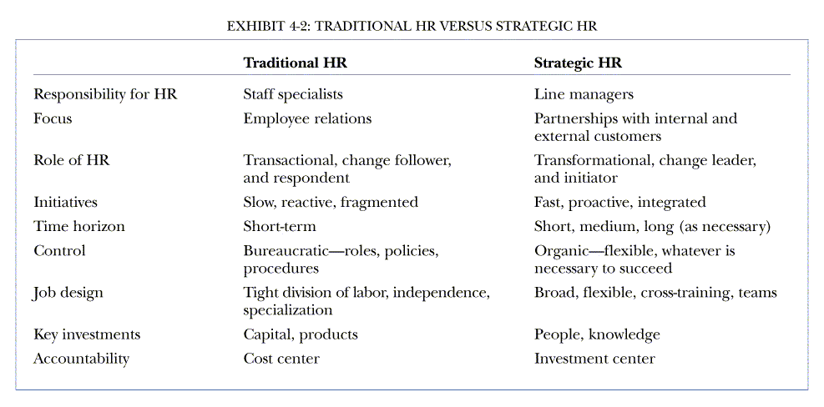
Traditional HRM v SHRM

Slide 20
Characteristics of SHRM

Slide 21
5 Ps
In this sense, a HR strategy is concerned with the challenge of matching the
Philosophy,
Policies,
Programmes,
Practices and
Processes
The ‘ﬁve Ps’ – in a way that will stimulate and reinforce the different employee role behaviours appropriate for each competitive strategy

Slide 22
Key Areas of SHRM
Job analysis and design
Recruitment and selection
Employee learning and development
Performance management
Pay structure, incentives and benefits
Industrial relations

Slide 23
HR Strategies must…
reflect the strategic objectives and values of the organisation;
be taken into account in organisational strategies (and vice versa);
support culture, climate, and organisational processes to attract and retain good staff;
identify the organisation’s competencies and match people to these; and
sustain and build organisational commitment.

Slide 24
HR Competencies
Strategic positioners: understand evolving business contexts, stakeholder expectations and business requirements, and are able to translate them into talent, culture and leadership actions
Credible activists: build relationships of trust and have a clear point of view about how to build business performance

Slide 25
HR Competencies
Capacity builders: define, audit and create organisational capabilities required for sustainable organisational success
Change champions: initiate and sustain change at the individual, initiative and institutional levels

Slide 26
HR Competencies
HR innovators and integrators: look for new ways to implement HR practices and integrate those separate practices to deliver business solutions
Technology proponents: use technology for efficiency to connect employees and to leverage new communication channels, such as social media

Slide 27
The HRM Challenge
HR Managers need to:
be strategic contributors;
show the true value of the HR function to the organisation;
be the employees’ voice; and
demonstrate professional competence.
HR managers need to constantly demonstrate the connection between HR, organisational performance and employee well-being.

Slide 28
Summary
The shift from an industrial society to an information society also presents HRM with unique challenges, including:
creating a fair and just workplace;
managing people respectfully and creatively;
restoring trust lost through restructuring, downsizing and work pressures.

Slide 29
Summary….
SHRM means to proactively provide a competitive advantage through the company’s human resources
The HR function needs to be integral to strategy formulation
HRM has an impact on strategy implementation
The strategic role of the HR function requires business, professional–technical, change management and integration competencies

